Slide 1
ONLINE HORTICULTURE SHOP Mini Project]
GUIDE: Rini Kurian
Department of MCA
Submitted by
Hima M S
S3 RMCA A
Rollno: 41

Slide 2
ONLINE HORTICULTURE SHOP
The central concept of the applicationis to allow the customer to shop virtually using the internet and allow customers to buy theitem of their desires from the shop. The Server process the customer and the items areshipped to the address submitted by them.
The customer can view the plant either by using the plant name or by the categories. It mainly contain two users and including payment.
Admin
Users

Slide 3
Table Design
Table No 01:Admin_info
Primary key : admin_id
Fieldname | Datatype | Size | Description
admin_id | Varchar | 15 | Primary key of admin_info
adminname | varchar | 10 | admin name
username | Varchar | 25 | username
password | Varchar | 25 | password

Slide 4
Table Design(continue…)
Table No 02:brand
Primary key : brand_id
Filedname | Datatype | Size | Description
brand-id | Int | 10 | PrimarykeyofTypetable
brand-title | Varchar | 30 | To storetypes

Slide 5
Table Design(continue…)
Table No 03 : category
Primary key :cat_id
Filedname | Datatype | Size | Description
Cat-id | Int | 10 | PrimarykeyofCategory
Category-name | Varchar | 30 | To storecategorynames

Slide 6
Table Design(continue…)
Table No 04 : product
Primary key :product_id
Fieldname | Datatype | size | Description
Product-id | Int | 10 | PrimarykeyofProducttable
product_category-id | Int | 10 | Foreignkeyofcategorytable
Product-type | varchar | 30 | ForeignkeyofTypetable
Product-title | Varchar | 10 | Titleofproduct
Product-price | varchar | 20 | Priceofproduct
Product-discription | Varchar | 500 | Aboutproduct
Product-image | Varchar | 300 | Imagesofproduct
Product-keyword | Varchar | 50 | Productkeyword

Slide 7
Table Design(continue…)
Table No 05 : user
Primary key :user_id
Fieldname | Datatype | size | Description
User-id | Int | 10 | PrimarykeyofUsertable
First-name | Varchar | 10 | Firstnameofuser
Last-name | Varchar | 10 | Last-nameofuser
Email | Varchar | 40 | Enailaddressofuser
password | Varchar | 40 | Storepasswordoftheuser
Mobile | int | 12 | Mobile number ofuser
address | Varchar | 60 | Addressofuser

Slide 8
Table Design(continue…)
Table No 06 : order
Primary key :order_id
Filedname | Datatype | Size | Description
_ order-id | Int | 10 | PrimarykeyofOrdertable
User_id | Varchar | 10 | Foreignkeyofusertable
Product-id | Int | 10 | Foreignkeyofproducttable
qty | Varchar | 50 | Quantity ofproduct
status | Varchar | 40 | Status of theproduct

Slide 9
Table Design(continue…)
Table No 07 : cart
Primary key :id
Filedname | Datatype | Size | Description
_ cart-id | Int | 10 | PrimarykeyofCarttable
Product-id | Varchar | 10 | Foreignkeyofproducttable
User-id | Varchar | 40 | Foreignkeyofusertable
qty | Varchar | 50 | Quantity ofproduct
Table No 08: order_product
Primary key :orderpro_id
Filedname | Datatype | Size | Description
_ orderpro_id | Int | 10 | PrimarykeyofOrderproducttable
Order-id | Varchar | 40 | Foreignkeyofusertable
qty | Varchar | 50 | Quantity ofproduct
amount | Varchar | 40 | Amountofproduct

Slide 10
Table Design(continue…)
Fieldname | Datatype | size | Description
order_d | Int | 10 | Primarykey
user_id r | int | 10 | foreign key
fproduct_id | Varchar | 10 | product id
qty | Varchar | 40 | quantity
ref_id | Varchar | 40 | referid
p_status | varchar | 12 | statusm of product
status | Varchar | 60 | status

Slide 11
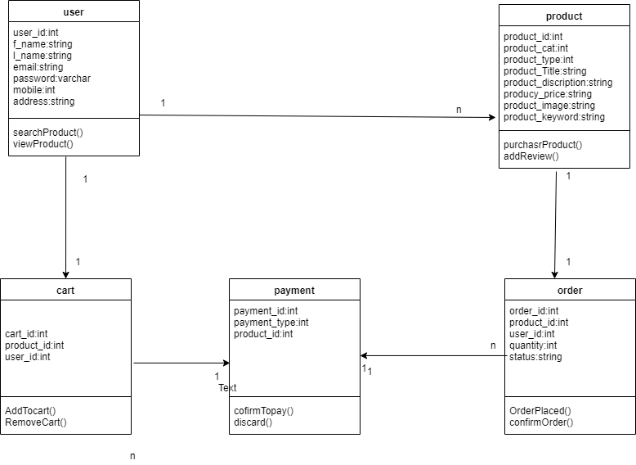
UML Diagrams
Class Diagram

Slide 12
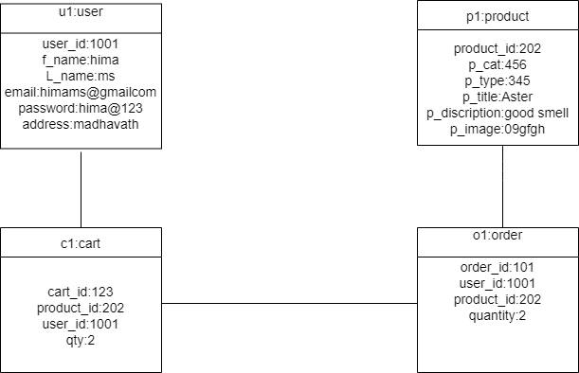
UML Diagrams(continue…)
Object Diagram

Slide 13
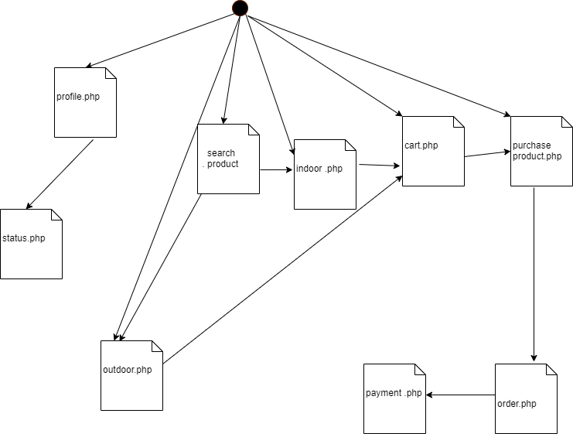
UML Diagrams(continue…)
Component Diagram

Slide 14
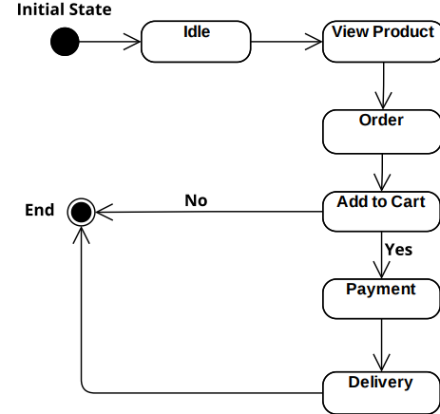
UML Diagrams(continue…)
State Diagram

Slide 15
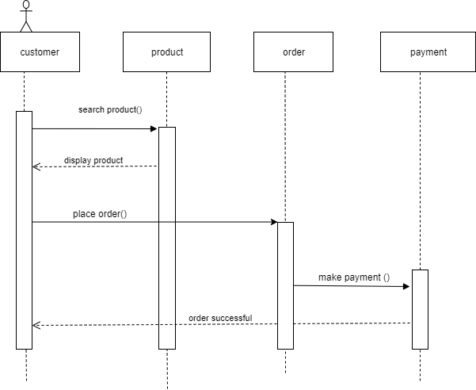
UML Diagrams(continue…)
Sequence Diagram

Slide 16
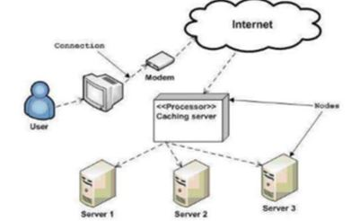
UML Diagrams(continue…)
Deployment Diagram

Slide 17
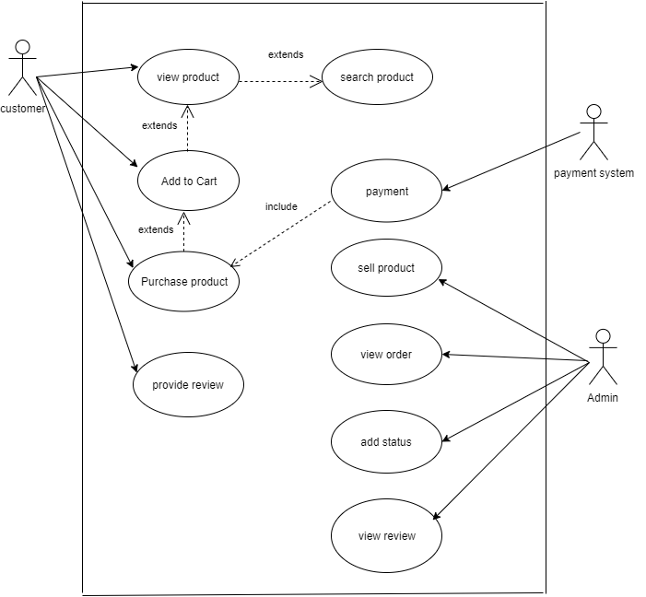
UML Diagrams(continue…)
Usecase Diagram

Slide 18
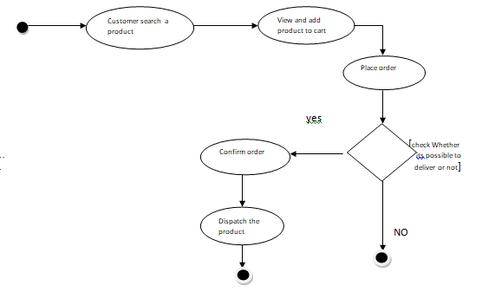
UML Diagrams(continue…)
Activity Diagram

